Slide 1
ANSC 6100
Predicting Health Insurance Premium Charges
Abelhard Jauwena
Olusegun Odumosu
Nishita Sharif

Slide 2
Insurance Premium
Analysis Outline
1
Objectives
2
Data
3
Data Preparation
4
Model Optimization
Objectives
Data
Data Preparation
Model Optimization
Models
Comparison of Models
Discussion
Conclusion
5
Models
6
Comparison of Models
7
Discussion
8
Conclusion
Notes:
Ideas for “sections” of the presentation:
The problem/objective (Segun) - 1min
The data (Nishita) - 1min
Visualization of data
Also explain with those figures why we stratified by charges and by smoker
Also explain the classes we created
How we handled outliers (Segun) - 1min [Data Preparation]
How we did feature selection and hyperparameter tuning (Abel) - 2min [Model Optimization]
Individual model discussion (Abel, Segun, Nishita) - 2min each
Learning curves
Comparison of models (classifier and regressor) (Abel and Nishita) - 2min
Stuff we struggled with (Nishita) - 1min [Discussion]
Conclusion (Segun) - 1min

Slide 3

Objectives
Health insurance:
Median household income in the United States $67,521²
Average cost of health insurance in the United States is $7,911¹
Some subsidies:
Medicaid (low income individuals)
Children’s Health Insurance Program (CHIP)
Affordable Care Act (ObamaCare)
Objective
Data
Data Preparation
Model Optimization
Models
Model Comparison
Discussion
Conclusion

Slide 4
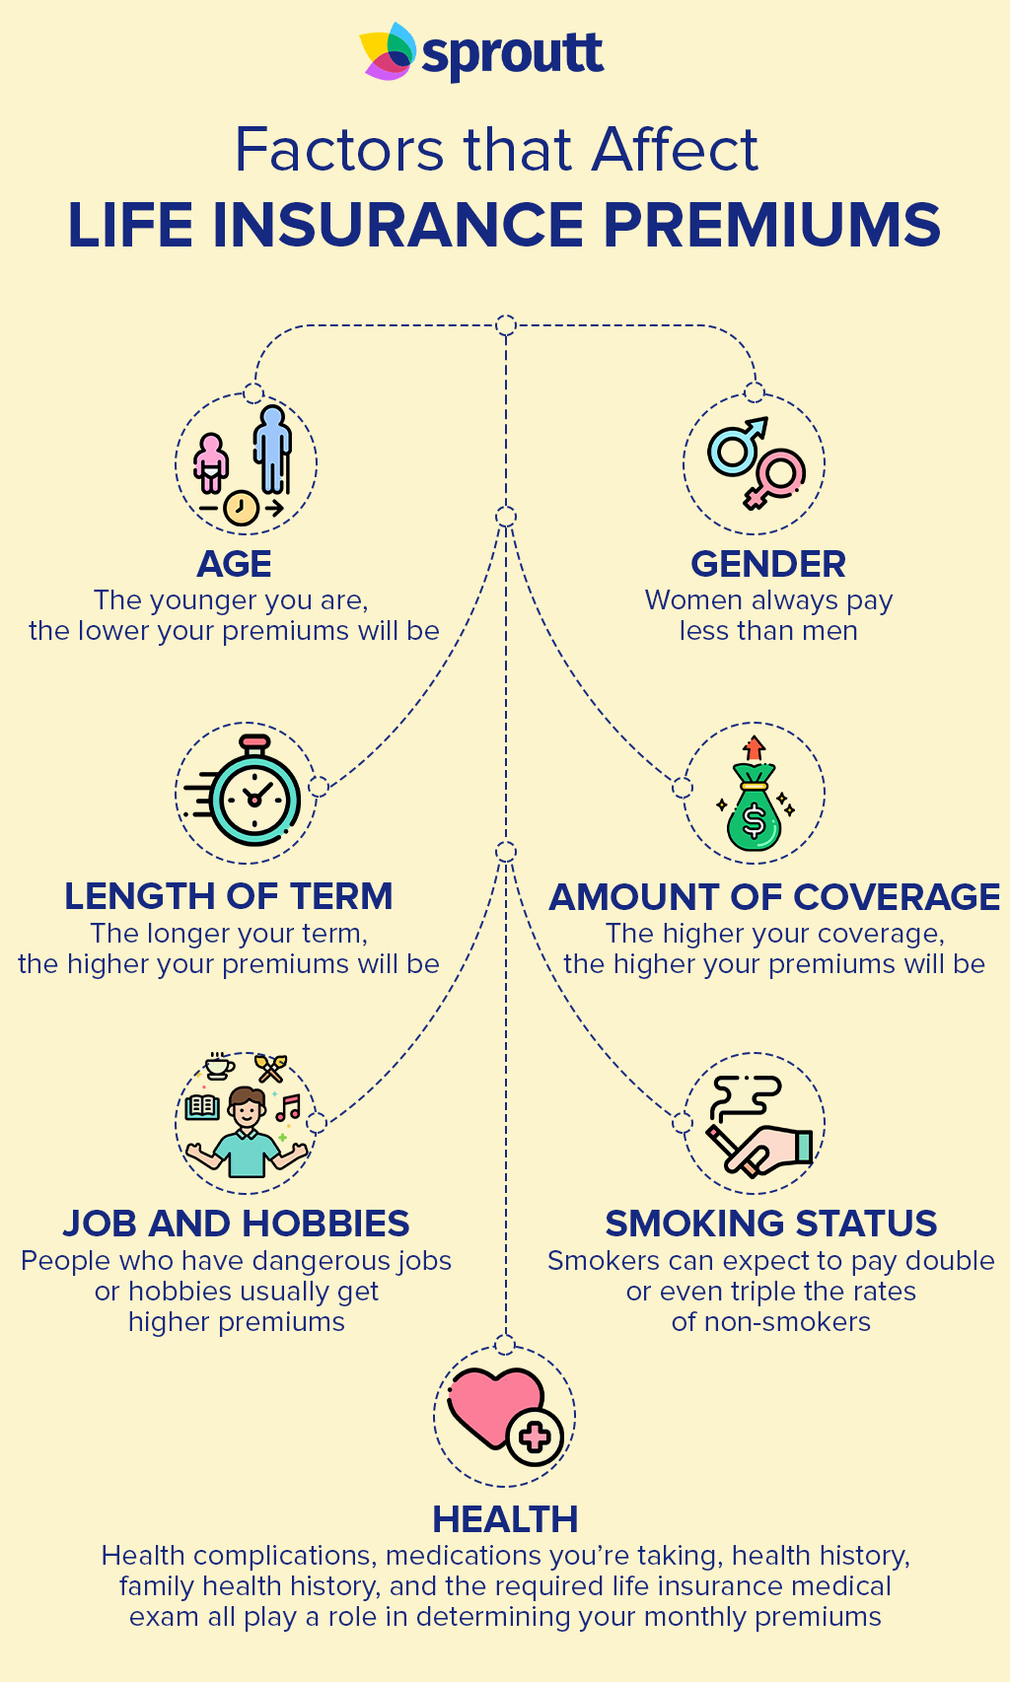
Objectives
Factors that affect health insurance:
Age, gender, length of term, amount of coverage, job and hobbies, smoking status, health, plan type, state of residence, type of insurance.
Dataset:
Insurance premium data set includes records for 1338 individuals (Jain, 2020).
Features (6): age, BMI, number of children, sex, smoking status, and the region of residence.
Objective
Data
Data Preparation
Model Optimization
Models
Model Comparison
Discussion
Conclusion

Slide 5
Objectives
Aim of project:
Regressor – Predict the health insurance premium with these features
Classifier – Predict whether the health insurance premium would be in the low, medium, or high range
Identify the most important factors that determine health insurance
Objective
Data
Data Preparation
Model Optimization
Models
Model Comparison
Discussion
Conclusion

Slide 6
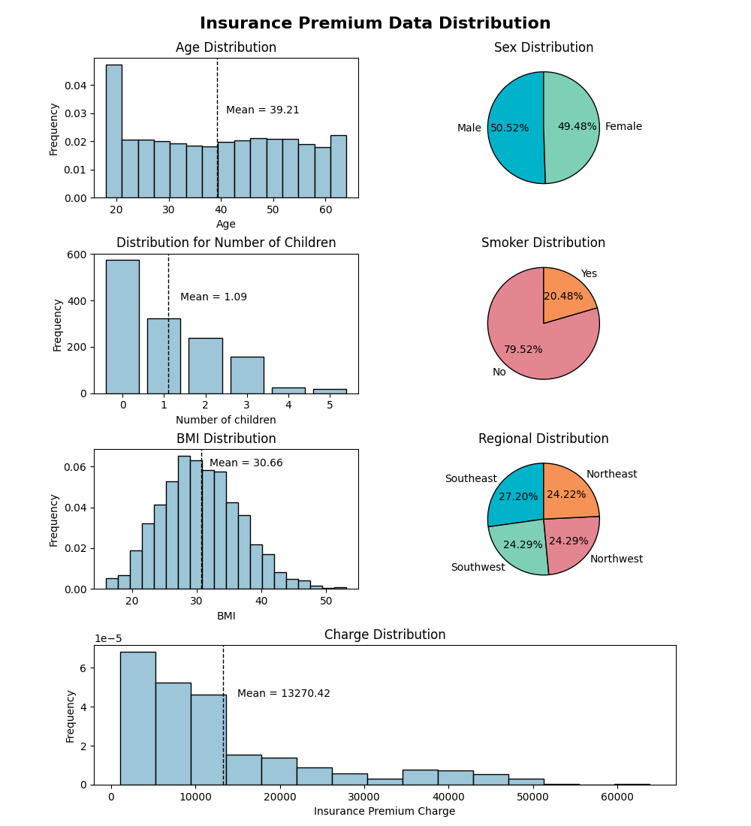
Data
Visualizing the data before processing
Stratifying the data for splitting
Creating classes for classifiers
Objective
Data
Data Preparation
Model Optimization
Models
Model Comparison
Discussion
Conclusion
Notes:
Visualized the dataset before pre-processing, cleaning up data, and analysis
Stratified by smoker and charges: They’re unevenly distributed
For the classifiers, we used quantiles to get even class sizes:

Slide 7
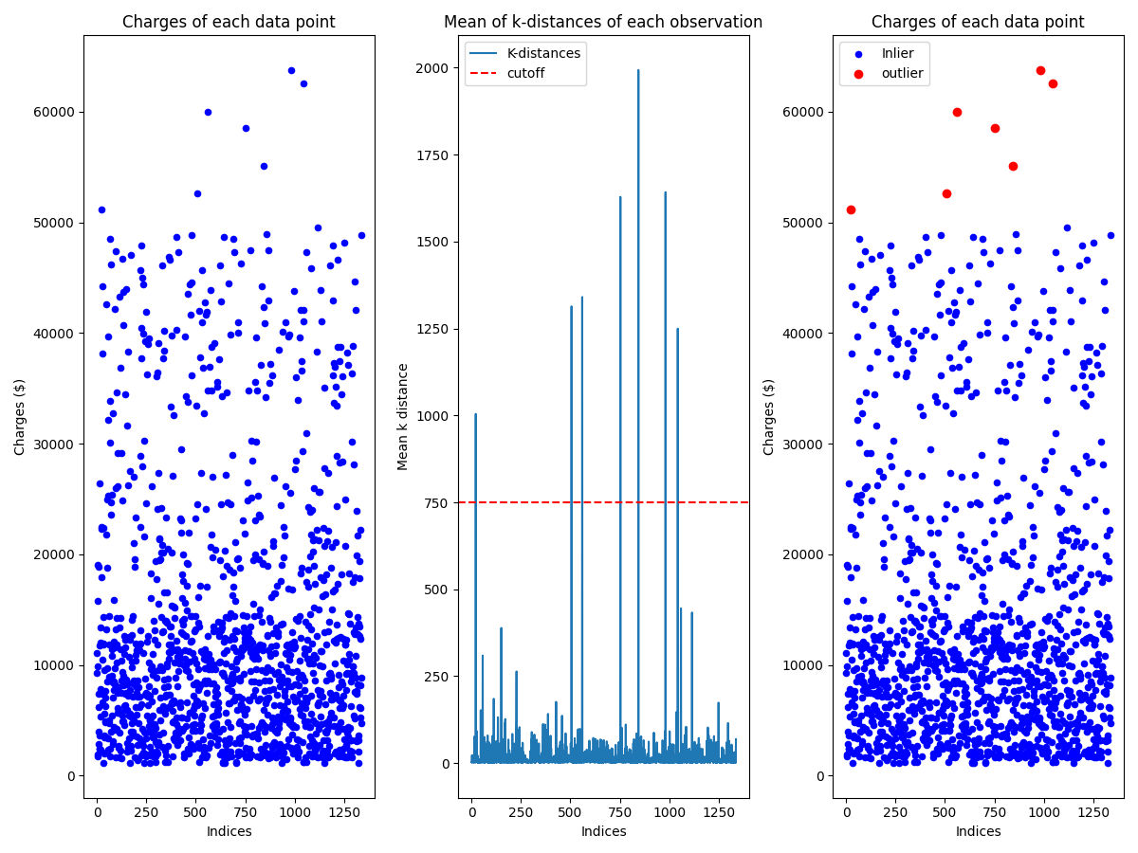
Preparing Data
Check for NAs
Convert features to appropriate data types
Bin charges to 3 categories
One hot encoded (sex and region)
Shuffle data
Outliers – KNN clustering
K = 3
Why this cutoff?
Objective
Data
Data Preparation
Model Optimization
Models
Model Comparison
Discussion
Conclusion

Slide 8
Optimizing Models
Feature Selection:
Permutation Feature Importance
Hyperparameter optimization:
SVM – RandomizedSearchCV
AdaBoost – BayesSearchCV
KNN Regressor – Obtained R2 and RMSE scores for k values from 1 to 50
KNN Classifier – Obtained mean prediction error, accuracy scores, and F1 scores for k values from 1 to 50
Objective
Data
Data Preparation
Model Optimization
Models
Model Comparison
Discussion
Conclusion

Slide 9
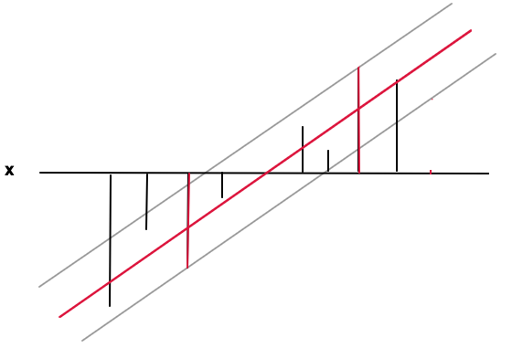
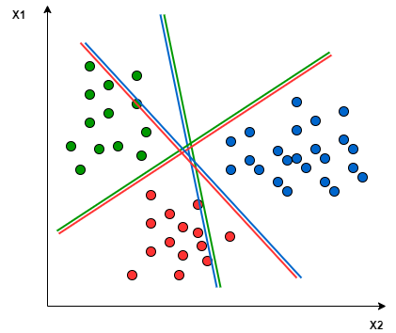
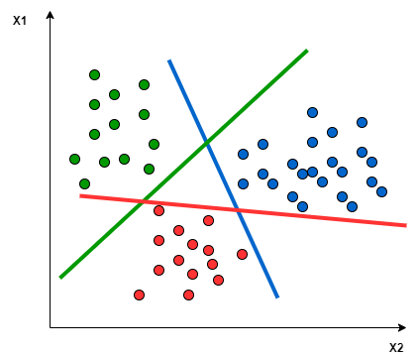
Support Vector Machine
Hyperplanes
How does it work?
Advantages and disadvantages
Hyperparameters:
Kernel
Degree
C
Classifier: OVO vs OVR
OVO
OVR
Objective
Data
Data Preparation
Model Optimization
Models
Model Comparison
Discussion
Conclusion
Notes:
How does it work:
Advantages and Disadvantages
Advantages
Robust against overfitting: has a regularization parameter to prevent overfitting; C
Disadvantages
Extremely sensitive to parameter tuning. Default parameters are often not adequate for predictions
Hyperparameters:
Kernel
Degree
C

Slide 10
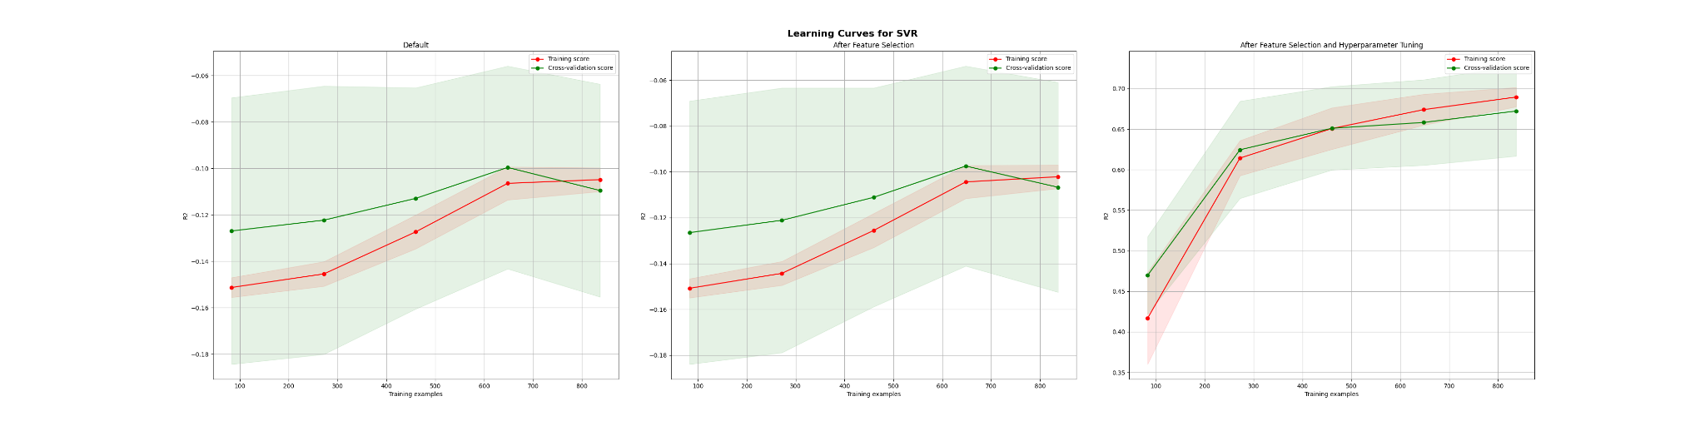
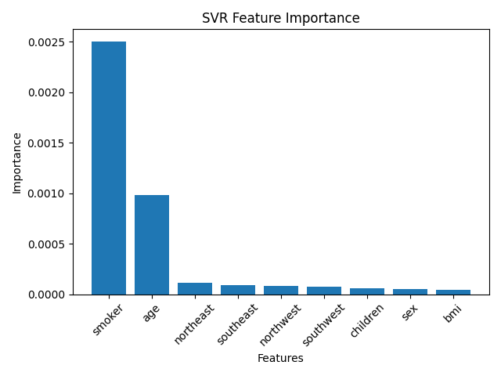
Support Vector Regressor – Learning Curves
Objective
Data
Data Preparation
Model Optimization
Models
Model Comparison
Discussion
Conclusion
Notes:
Note that R2 is actually negative before last figure

Slide 11
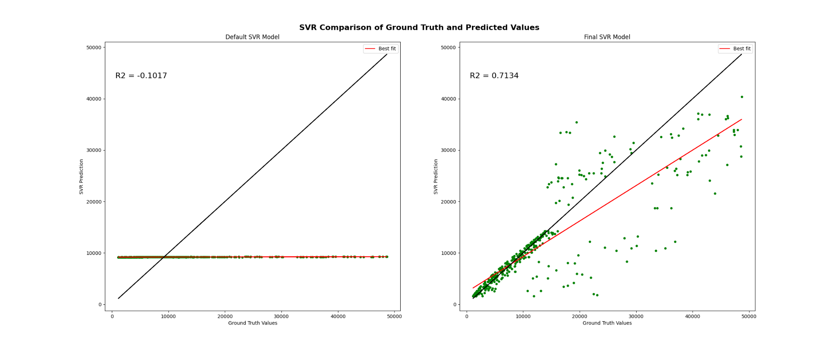
Support Vector Regressor – Scatter Plots
Objective
Data
Data Preparation
Model Optimization
Models
Model Comparison
Discussion
Conclusion
Notes:
Can see that the predictions are much closer to the true values at the lower end of charges. This makes sense given the distribution of charges; model didn’t have as much information for charges at the higher end, so it couldn’t learn as well

Slide 12
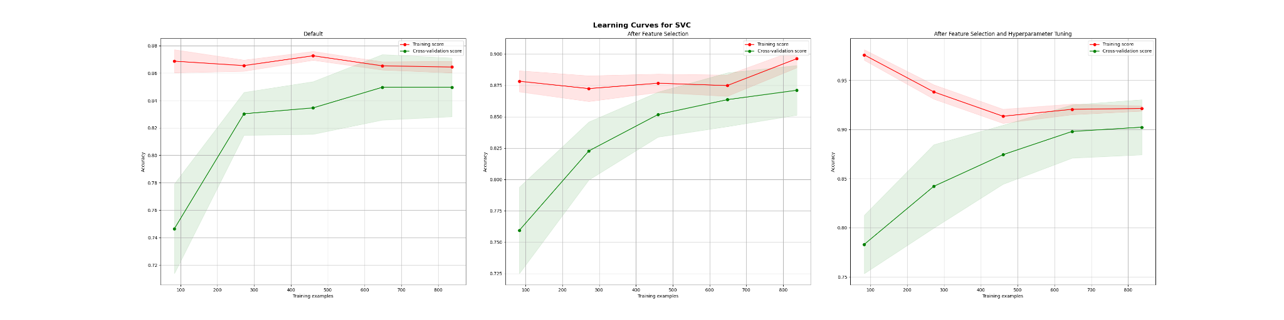
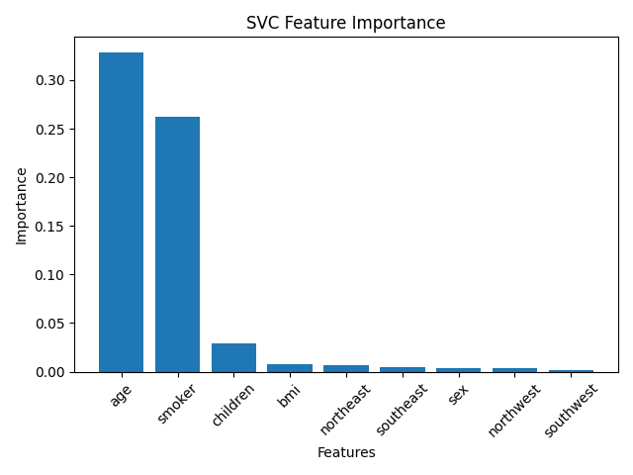
Support Vector Classifier – Learning Curves
Objective
Data
Data Preparation
Model Optimization
Models
Model Comparison
Discussion
Conclusion
Notes:
When talking about hyperparameter tuning: There are two approaches for support vector classification with more than two classes: One-vs-One and One-vs-Rest.
One-vs-Rest will create binary classifications where one class is compare to the rest of the dataset
One-vs-One will create binary classifications where one class is compared to another class
When hyperparameter tuning, Random Search chose OVO

Slide 13
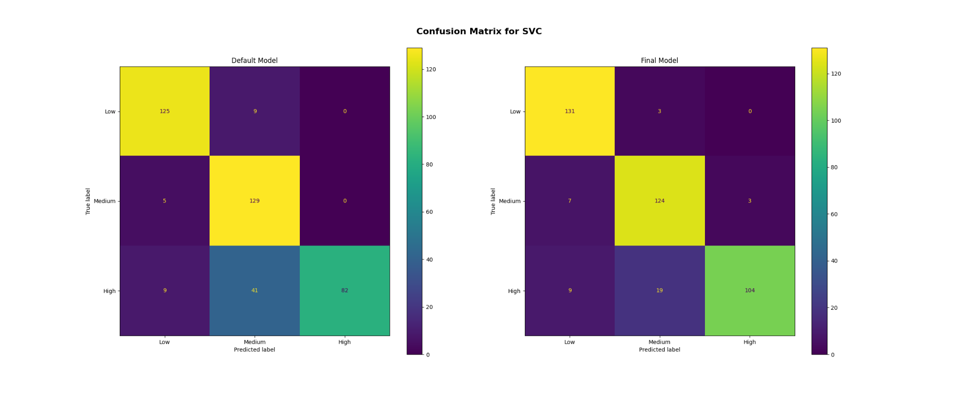
Support Vector Classifier – Confusion Matrices
Objective
Data
Data Preparation
Model Optimization
Models
Model Comparison
Discussion
Conclusion

Slide 14
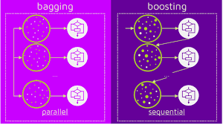
AdaBoost
Ensemble method
How does it work?
Advantages and disadvantages
Hyperparameters:
Regressor: Number of estimators, learning rate, loss, base estimator
Classifier: Number of estimators, learning rate, algorithm (SAMME VS SAMME.R), base estimator
Objective
Data
Data Preparation
Model Optimization
Models
Model Comparison
Discussion
Conclusion

Slide 15
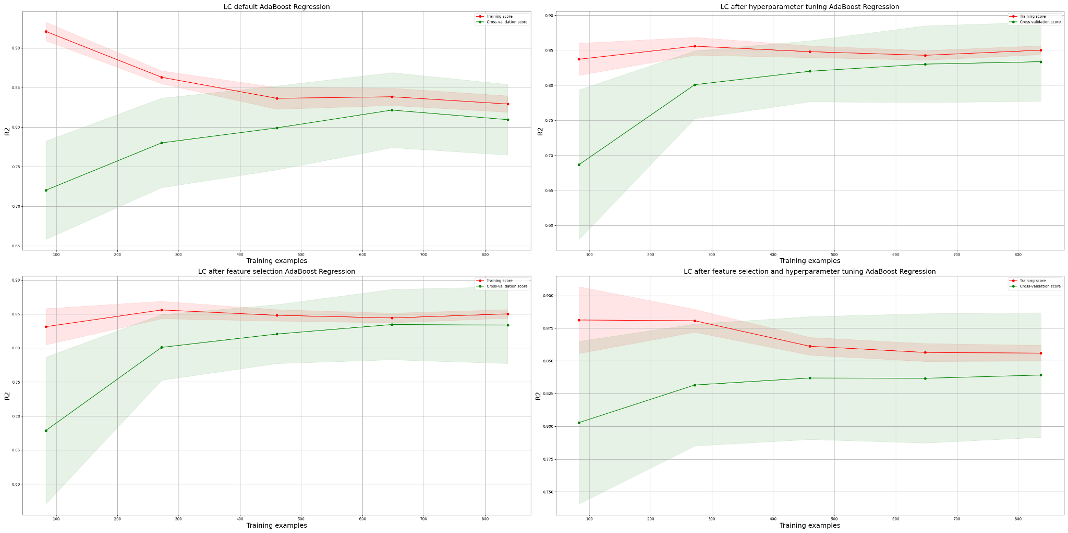
AdaBoost Regressor – Learning Curves
Objective
Data
Data Preparation
Model Optimization
Models
Model Comparison
Discussion
Conclusion

Slide 16
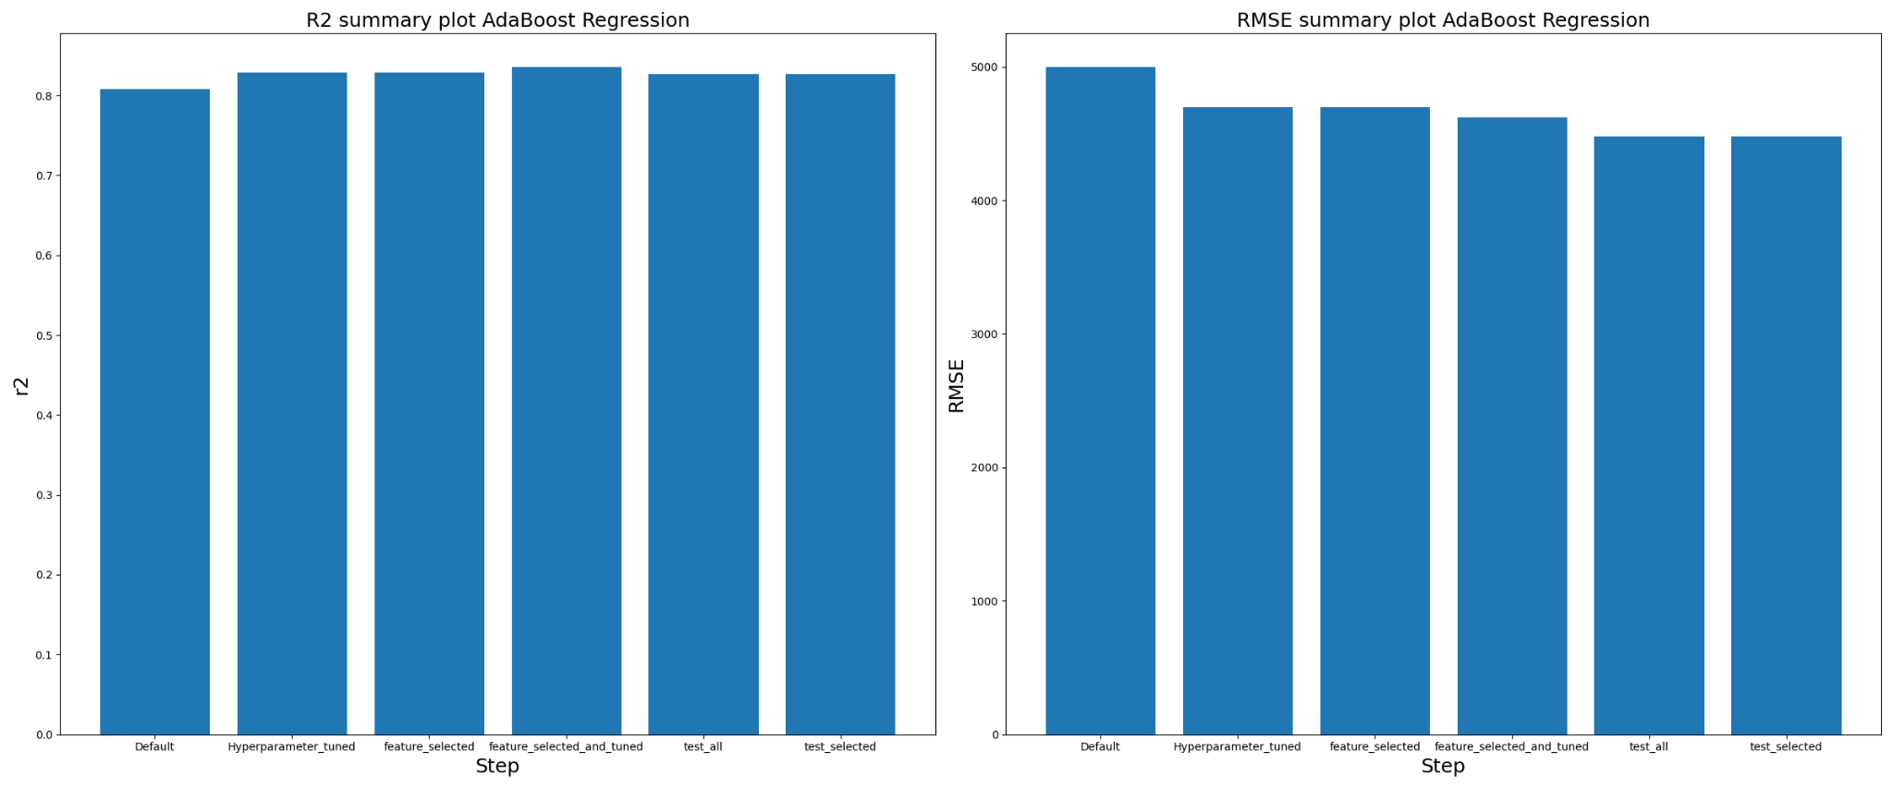
AdaBoost Regressor – Evaluation Metrics
Objective
Data
Data Preparation
Model Optimization
Models
Model Comparison
Discussion
Conclusion

Slide 17
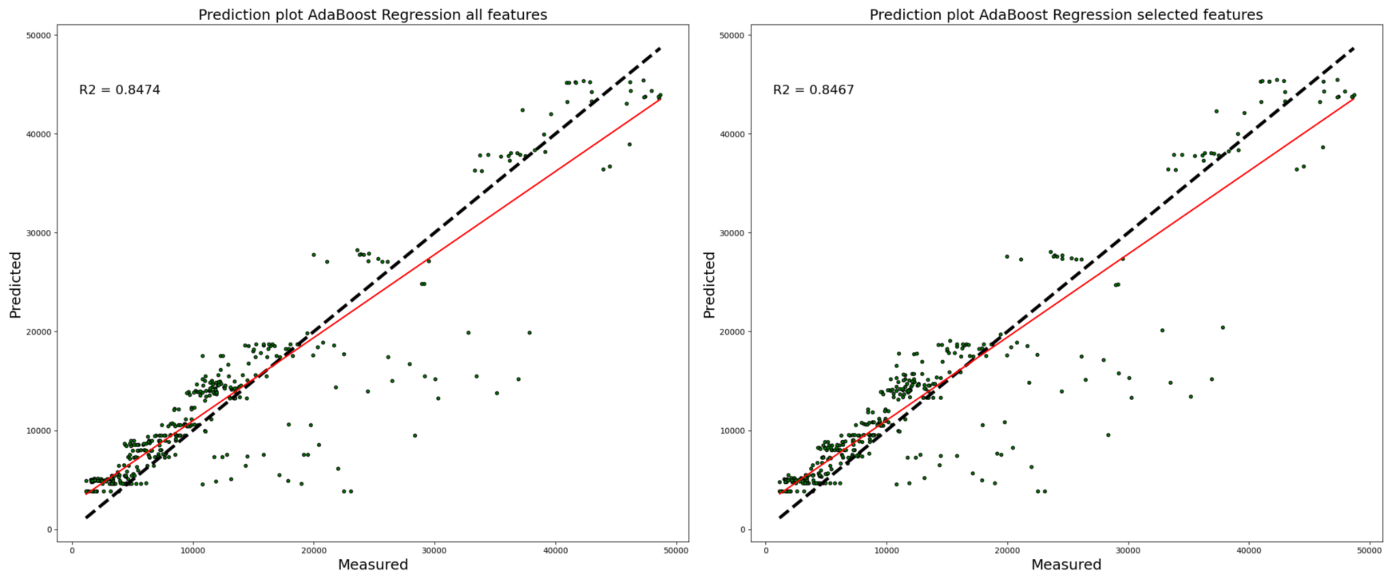
AdaBoost Regressor – Scatter Plots
Objective
Data
Data Preparation
Model Optimization
Models
Model Comparison
Discussion
Conclusion

Slide 18
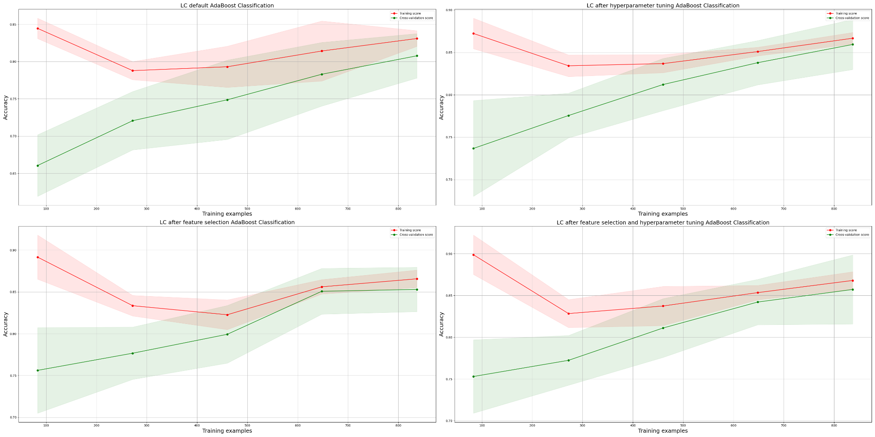
AdaBoost Classifier – Learning Curves
Objective
Data
Data Preparation
Model Optimization
Models
Model Comparison
Discussion
Conclusion

Slide 19
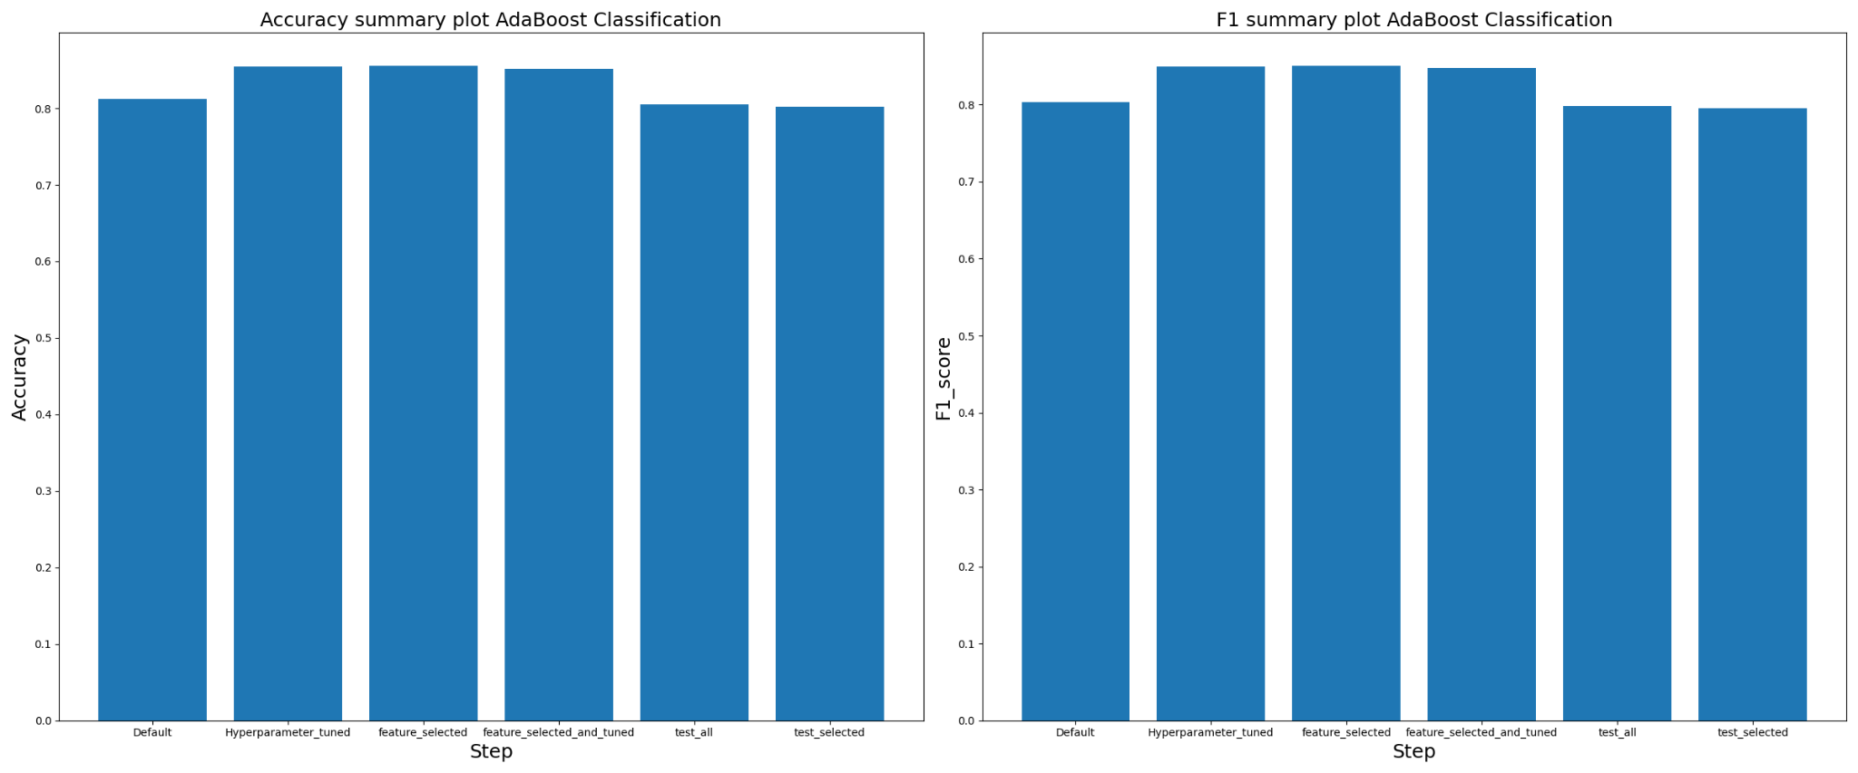
AdaBoost Classifier – Evaluation Metrics
Objective
Data
Data Preparation
Model Optimization
Models
Model Comparison
Discussion
Conclusion

Slide 20
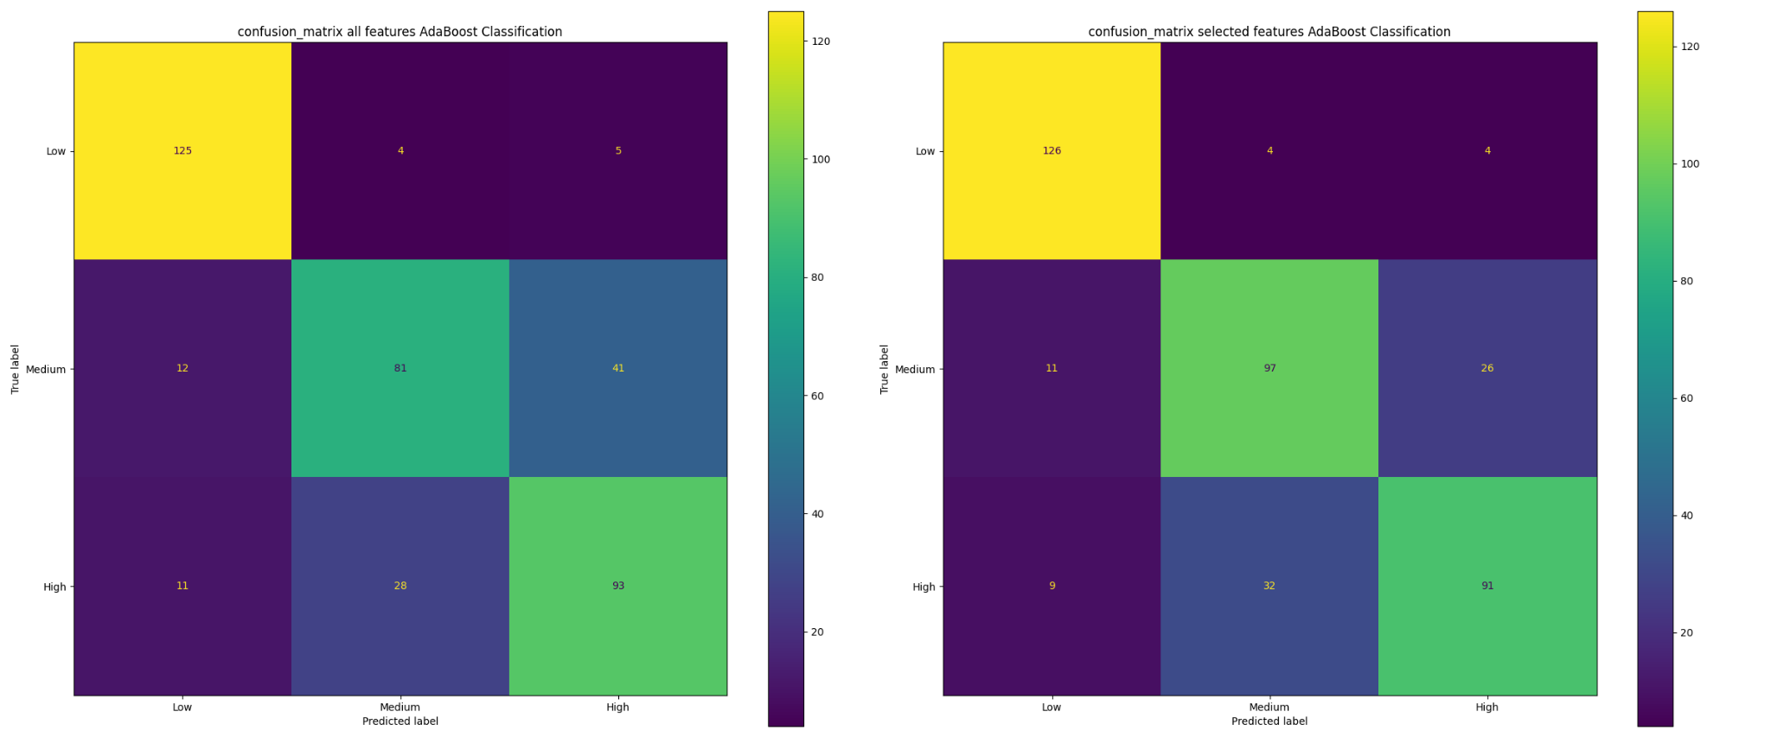
AdaBoost Classifier – Confusion Matrices
Objective
Data
Data Preparation
Model Optimization
Models
Model Comparison
Discussion
Conclusion

Slide 21
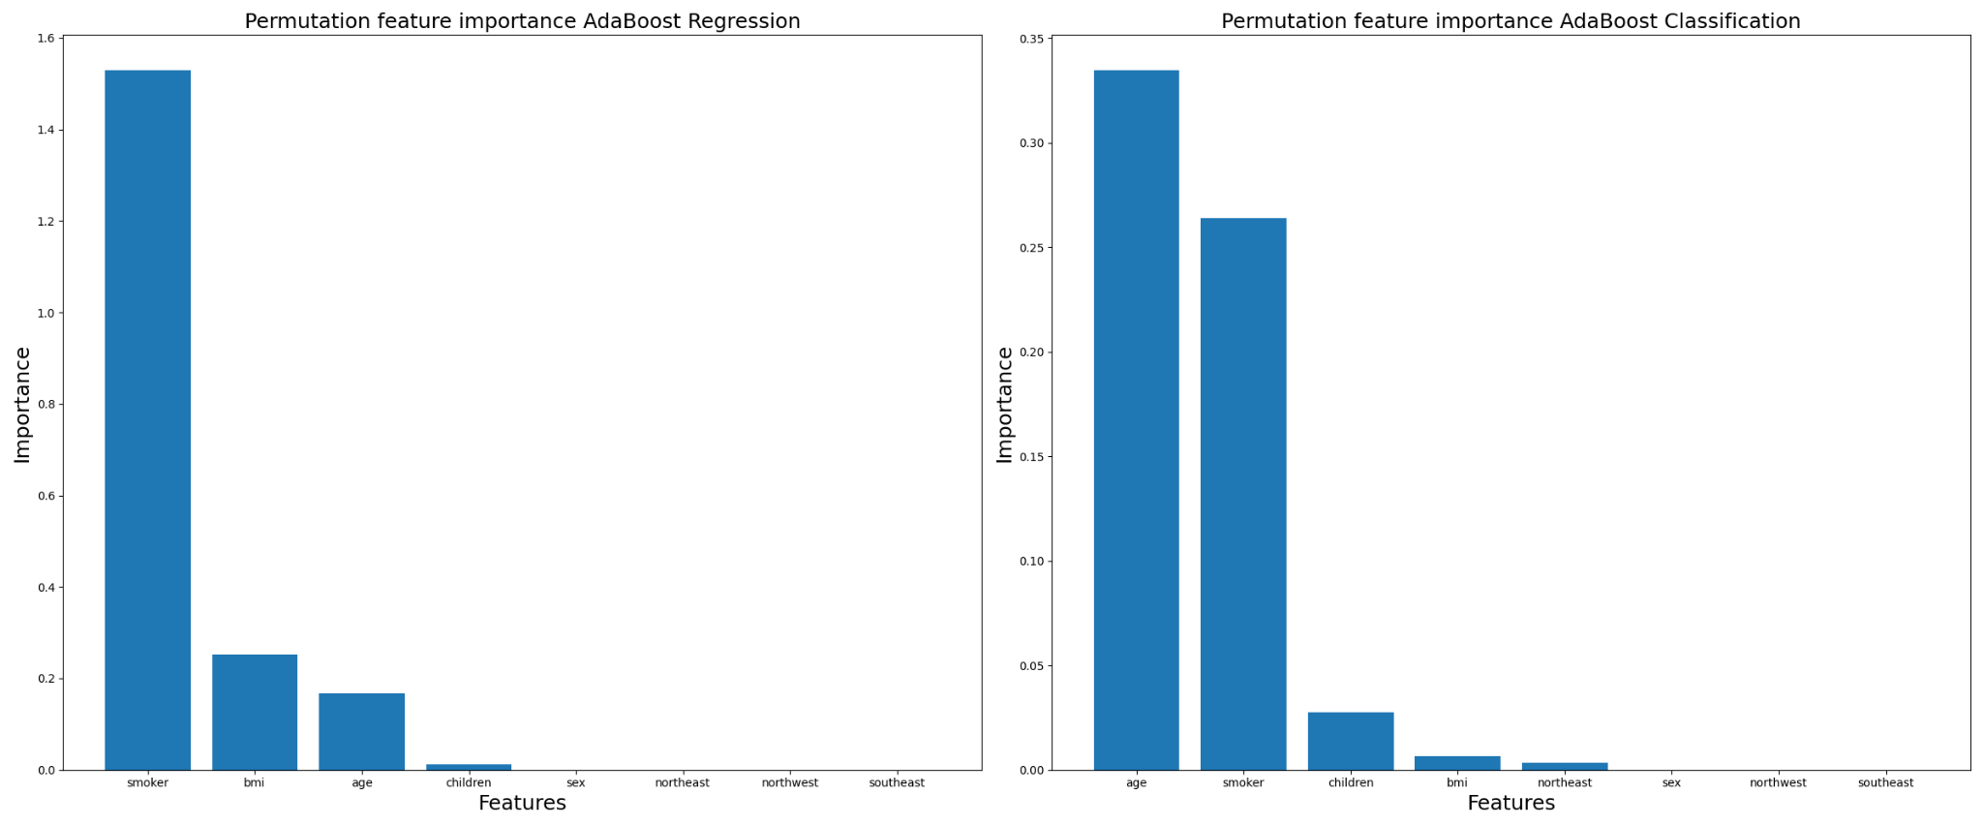
AdaBoost – Feature Selection
Objective
Data
Data Preparation
Model Optimization
Models
Model Comparison
Discussion
Conclusion
Notes:
'smoker': 'bmi':, 'age': 'children':
'smoker': 'age':, 'children': 'bmi': , 'northeast':
Age smoker children bmi northeast
Smoker age location
Age bmi smoker children sex
Age bmi children smoker northeast
Position:
Age: 14
Smoker: 12
Bmi: 6

Slide 22
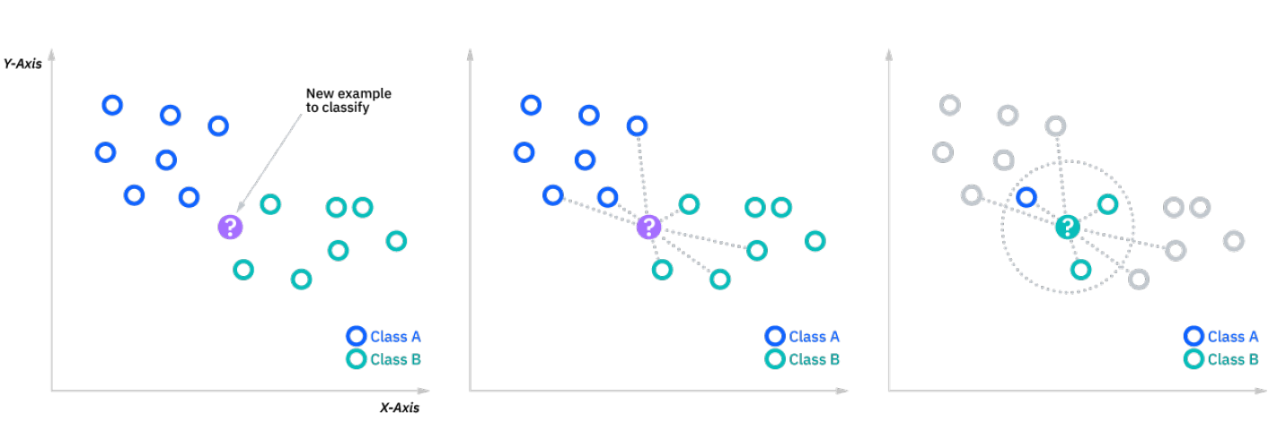
KNN
How does it work?
Hyperparameter: k.
Advantages and disadvantages.

Slide 23
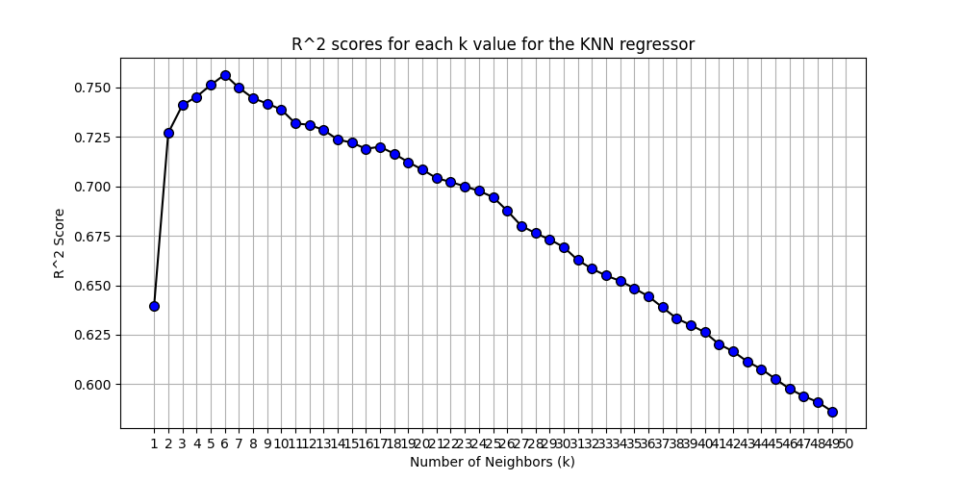
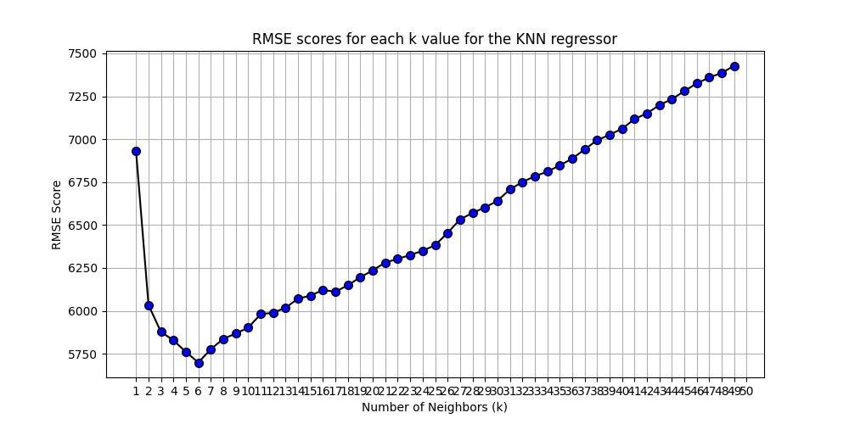
KNN Regressor – Choosing the Best k
Objective
Data
Data Preparation
Model Optimization
Models
Model Comparison
Discussion
Conclusion

Slide 24
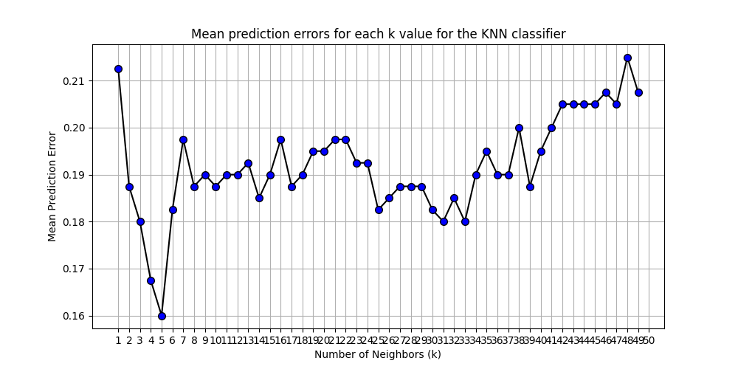
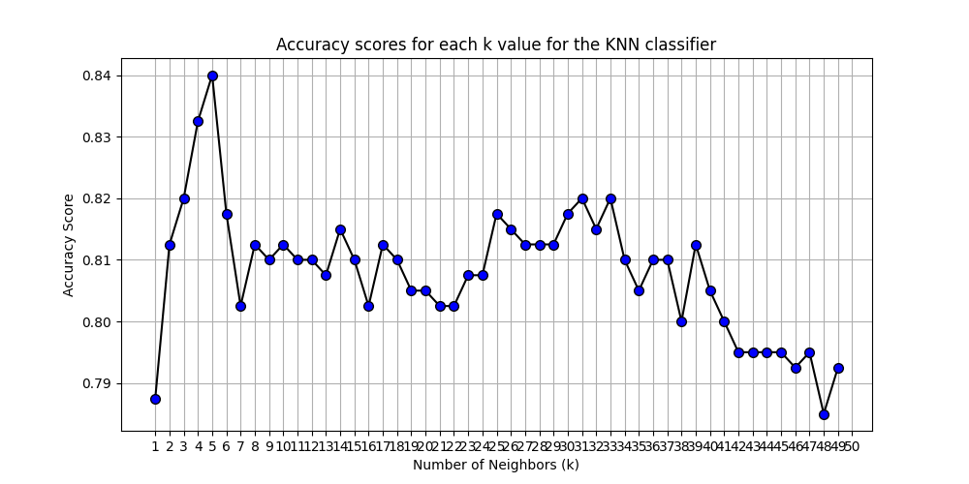
KNN Classifier – Choosing the Best k
Objective
Data
Data Preparation
Model Optimization
Models
Model Comparison
Discussion
Conclusion

Slide 25
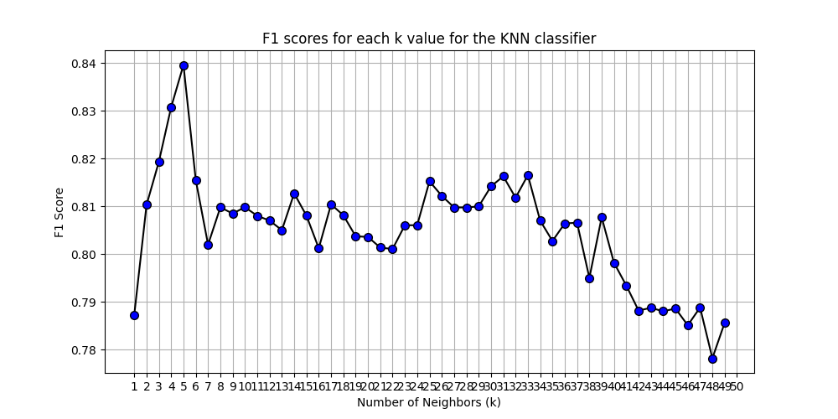
KNN Classifier – Choosing the Best k
Objective
Data
Data Preparation
Model Optimization
Models
Model Comparison
Discussion
Conclusion

Slide 26
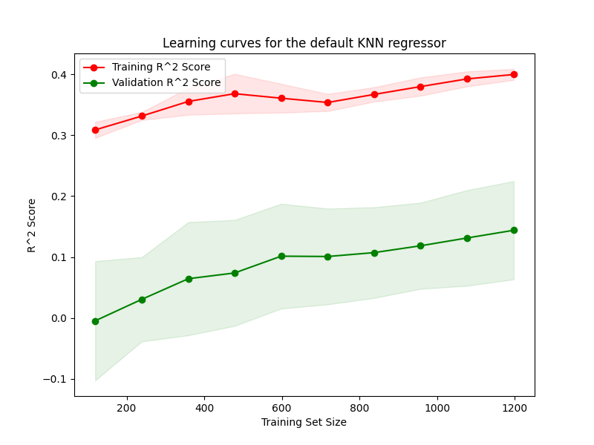
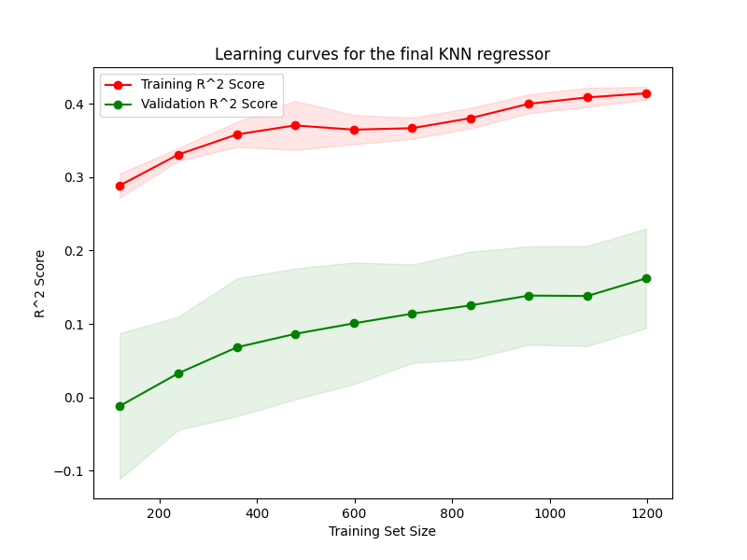
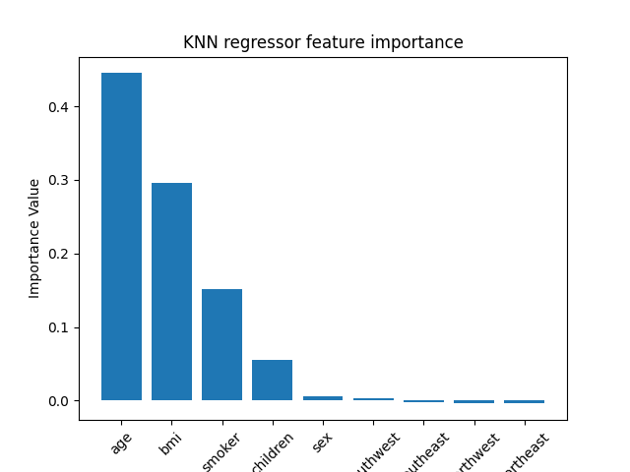
KNN Regressor – Learning Curves
Objective
Data
Data Preparation
Model Optimization
Models
Model Comparison
Discussion
Conclusion

Slide 27
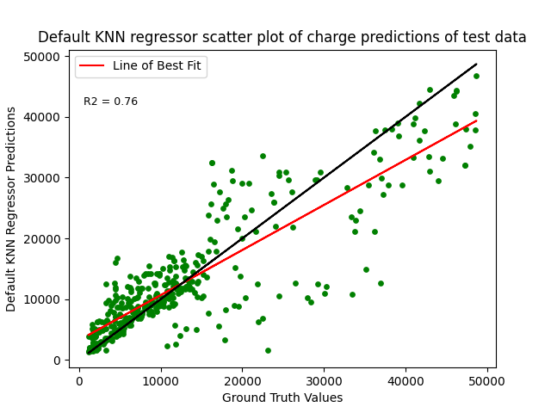
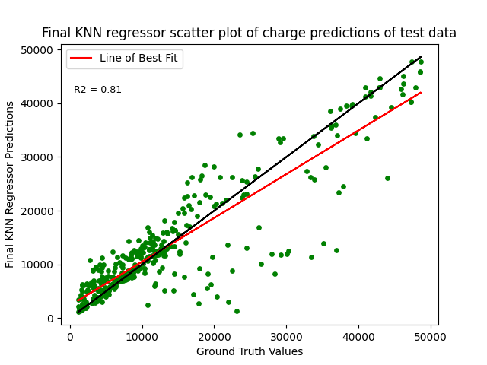
KNN Regressor – Scatter Plots
Objective
Data
Data Preparation
Model Optimization
Models
Model Comparison
Discussion
Conclusion

Slide 28
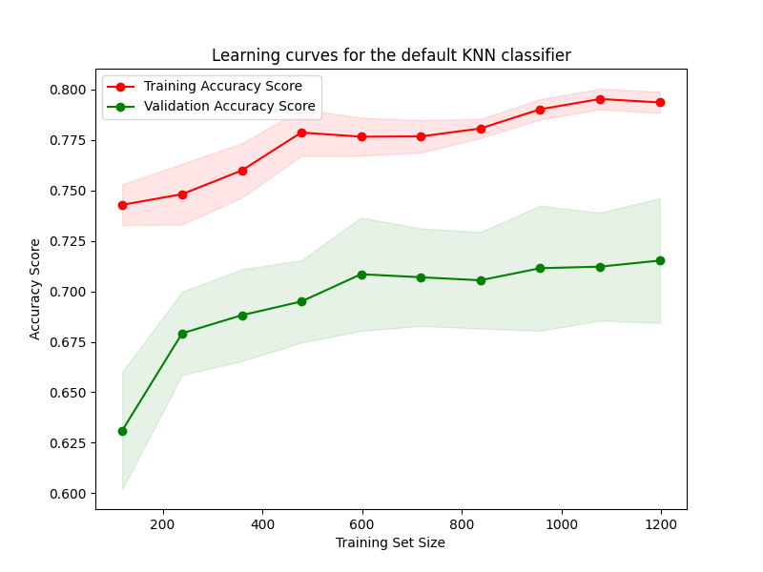
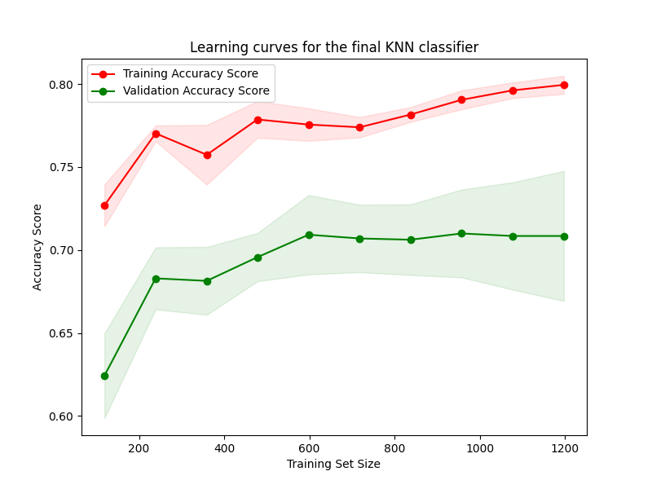
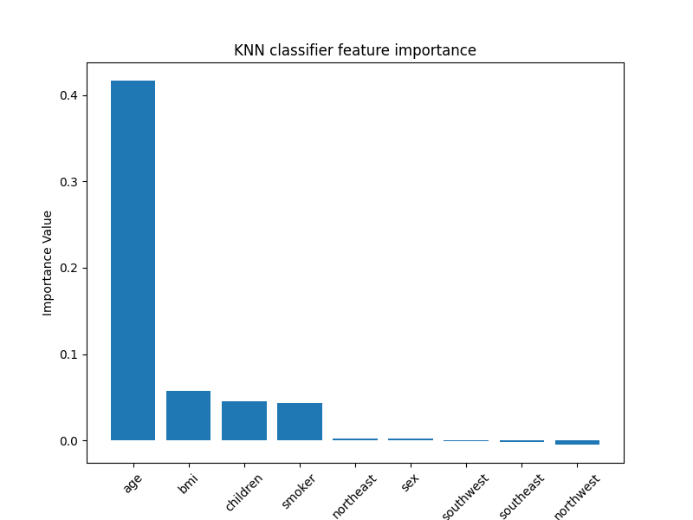
KNN Classifier – Learning Curves
Objective
Data
Data Preparation
Model Optimization
Models
Model Comparison
Discussion
Conclusion

Slide 29
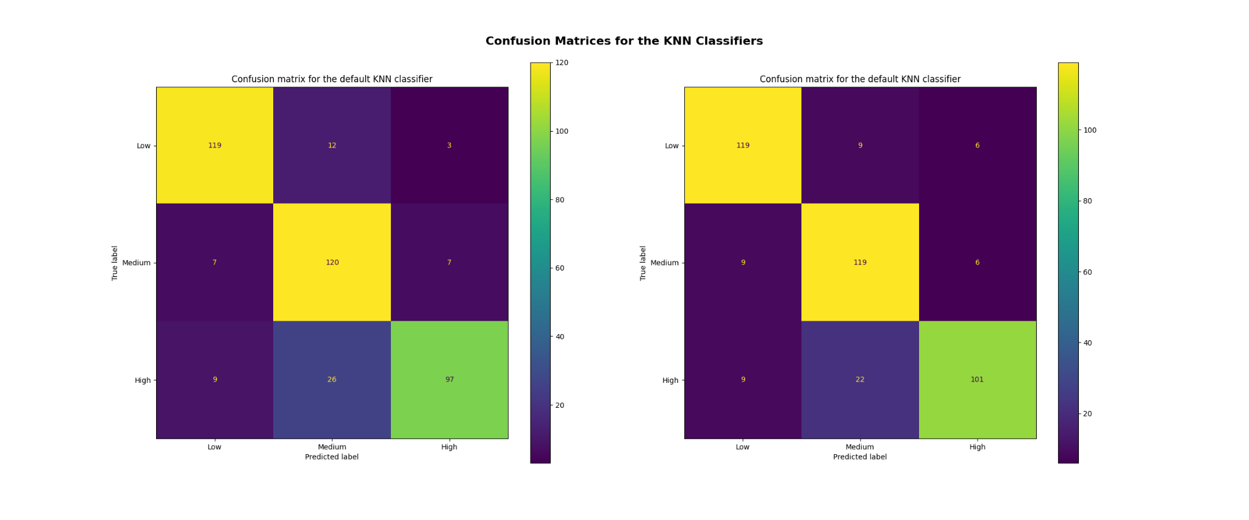
KNN Classifier – Confusion Matrices
Objective
Data
Data Preparation
Model Optimization
Models
Model Comparison
Discussion
Conclusion

Slide 30
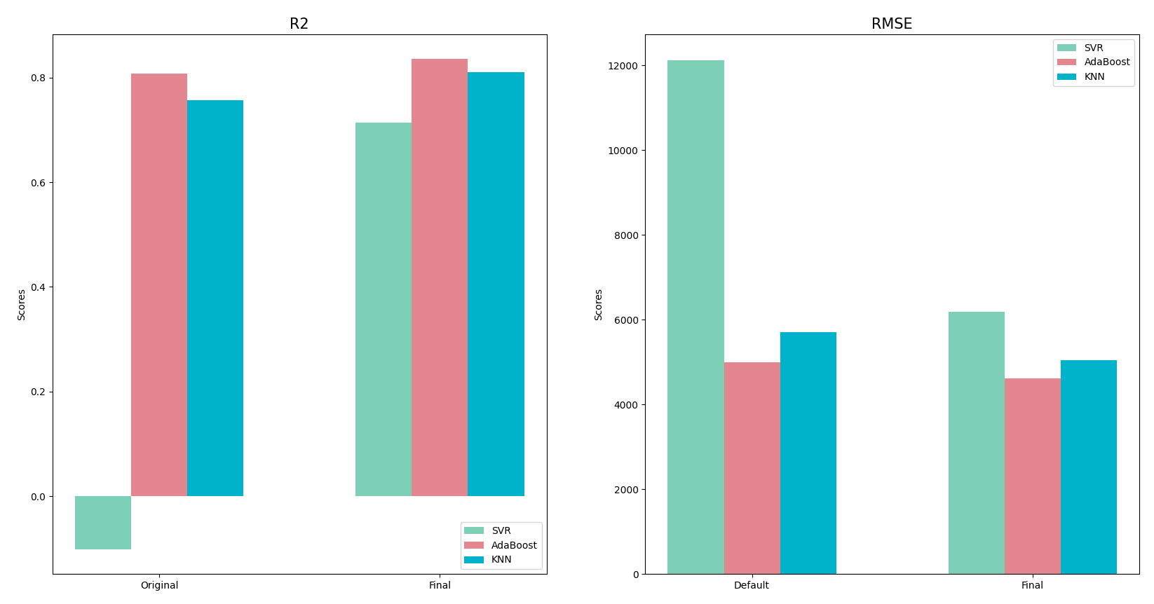
Comparing Regressors
Objective
Data
Data Preparation
Model Optimization
Models
Model Comparison
Discussion
Conclusion

Slide 31
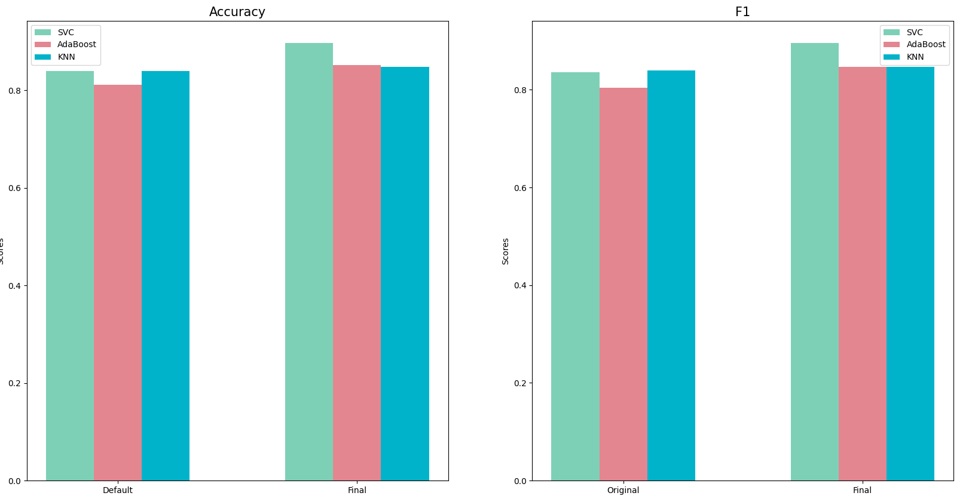
Comparing Classifiers
Objective
Data
Data Preparation
Model Optimization
Models
Model Comparison
Discussion
Conclusion

Slide 32
Discussion
SVM:
Default regressor performed poorly
Could not plot learning curve when tuning for gamma (program ran too long)
AdaBoost:
Ensemble method with decision tree
KNN:
Both regressor and classifier overfit
The accuracy and F1 scores of the classifier improved only slightly after selecting features
Objective
Data
Data Preparation
Model Optimization
Models
Model Comparison
Discussion
Conclusion
Notes:
Nishita:
SVR: Default model.
SVR: When hyperparameter tuning, couldn’t tune for gamma – ran for too long.
Segun Adaboost stuff:
Randomforest was overfitting.
Chose adaboost – ensemble method; so was hoping for more accurate results.
Abel:
Both KNN regressor and classifier were overfitting.
The accuracy and F1 scores for the KNN classifier improved only slightly after selecting features.

Slide 33

Conclusion
Main takeaways
Best model
Overfitting and underfitting
Random state?
Objective
Data
Data Preparation
Model Optimization
Models
Model Comparison
Discussion
Conclusion
Notes:
Age and smoker

Slide 34
Acknowledgements
We would like to thank Dr. Dan Tulpan for his guidance through the journey of machine learning all the while making us laugh in the process. This class felt a bit more than just learning about machine learning and we thank him!
Objective
Data
Data Preparation
Model Optimization
Models
Model Comparison
Discussion
Conclusion

Slide 35
References
2022 Employer Health Benefits Survey. (2022). Kaiser Family Foundation. https://www.kff.org/report-section/ehbs-2022-section-1-cost-of-health-insurance/#:~:text=The%20average%20premium%20for%20single,in%20large%20firms%20(%247%2C873).
Jain, S. (2020, September 9). Insurance Premium Data. Kaggle. https://www.kaggle.com/datasets/simranjain17/insurance
Pupale, R. (2018). Support Vector Machines (SVM) - An Overview. https://towardsdatascience.com/https-medium-com-pupalerushikesh-svm-f4b42800e989
Shrider, A. E., Kollar, M., Chen, F., & Semega, J. (2021). Income and Poverty in the United States: 2020. United States Census Bureau. https://www.census.gov/library/publications/2021/demo/p60-273.html
Singh, A. (2018, August 22). KNN algorithm: Introduction to K-Nearest Neighbors Algorithm for Regression. Analytics Vidhya. https://www.analyticsvidhya.com/blog/2018/08/k-nearest-neighbor-introduction-regression-python/
Objective
Data
Data Preparation
Model Optimization
Models
Model Comparison
Discussion
Conclusion

